Slide 1
Industry Briefing
HNC Aboriginal Health Partnership Communications Plan and Delivery Support- RFP
Susan Parker Pavlovic, Paul Fernon, Hollie Carney, Andy Roberts
5 May 2026, 12pm

Slide 3
Purpose and Agenda
Background and context​
  Healthy North Coast Aboriginal Health Partnership ​
Service specifications and requirements​
  Scope​
  Key stakeholders and target audience
  Reporting​
  Other Requirements​
Procurement approach & tender documents​
Application process​
Key dates – estimated timeline​
Proposal Requirements​
Questions​

Slide 4
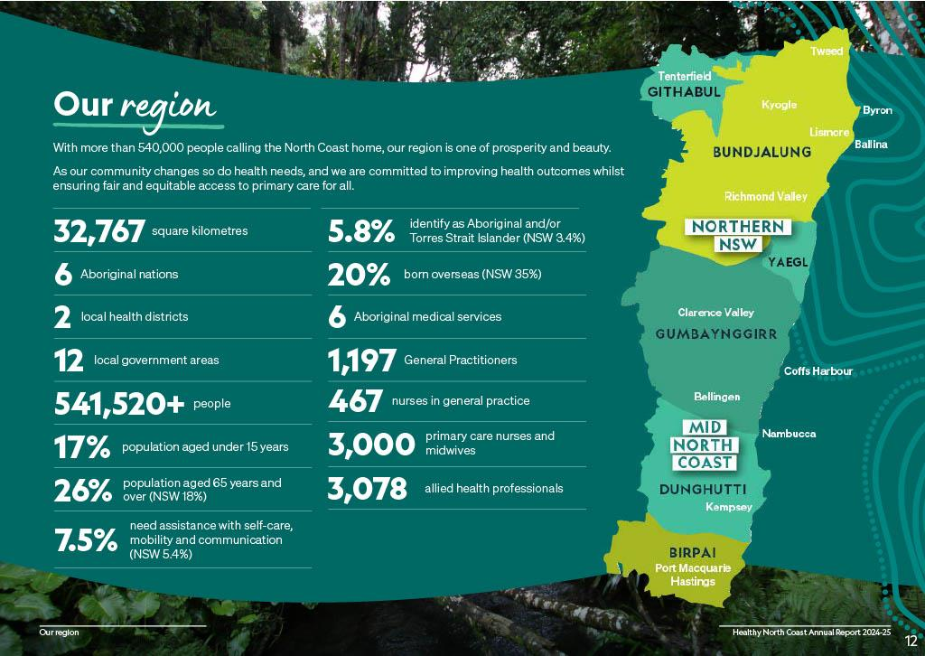

Slide 5

Healthy North Coast Aboriginal Health Partnership
The Healthy North Coast Aboriginal Health Partnership (AHP) unites six ACCHOs and Healthy North Coast (HNC). ​
The aim of the partnership is to strengthen regional planning, joint decision making and collaboration to improve health outcomes for Aboriginal communities across the North Coast. ​
The ACCHO CEOs and the CEO of Healthy North Coast are members of the AHP. ​
Since 2023, the AHP has delivered joint initiatives and explored opportunities for regional coordination.​

Slide 6
Program overview
Deliver communications for the Partnership including content creation, digital development, stories and social media
Work must align with: HNC branding guidelines, Aboriginal cultural safety expectations, AHP governance processes, and current HNC/Partner media & social channels.
All work is undertaken under the direction of the AHP and will be aligned with AHP governance
Budget - $60K for 12 months

Slide 7
AHP communication plan objectives
Communications will promote the work and achievements of the Aboriginal Health Partnership to community, partner organisations and funding bodies.
Promote opportunities for community and stakeholder participation.
Showcase collective achievements, positive impact on communities, and strengths‑based “good news” stories about Aboriginal health and determinants of health.
Focus includes promoting pathways into health careers for Aboriginal people

Slide 8
Scope of Services
Discovery & cultural grounding: review Partnership materials; engage AHP reps; confirm cultural considerations and decision pathways.
Visual identity elements (branding uplift within scope): logo/lock‑up options, colour/typography guidance, visual motifs/artwork guidance consistent with ICIP requirements, strengths‑based imagery guidance.
Brand assets & handover: priority templates; updated brand guide incl. co‑branding and approvals; accessible final files and handover to HNC.
Content creation & storytelling: regular digital/written content aligned to strengths‑based narratives, guided by the Partners (incl. Director AHP).

Slide 9
Scope of services (cont)
IPTAAS pilot resources: poster, brochure, factsheet, social tiles, web/CRM‑ready content pack
SEWB program resources: poster, brochure, factsheet, social tiles, web/CRM‑ready content pack
CRM / subscriber database & campaigns: integrate with HubSpot, design data fields/workflows, culturally appropriate onboarding pathways, consent and reporting.
Analytics & reporting: monthly performance insights, social performance, CRM engagement data, optimisation recommendation

Slide 10
Key stakeholders and target audience
Community:
Aboriginal communities across the North Coast (Elders, families, young people)
Aboriginal Health Partnership members
Health System:
Local Health Districts and partner health services
Government agencies and funding bodies
Key focus for communications:
Strengths‑based, culturally safe, community‑led messaging
Clear tailoring of content for community, ACCHOs and system stakeholders

Slide 11

Tactical communication elements
Minor branding upgrade
Social media tiles
Newsletter stories
Short video stories for social media and website
Photographs for use in stories
Program assets - posters, factsheets and brochures

Slide 12
Cultural governance and ways of working
All work conducted under Aboriginal Health Partnership governance and decision‑making processes
Alignment with Aboriginal cultural safety expectations
Demonstrated culturally safe practice throughout design and delivery
Respect for community control, Indigenous Data Sovereignty and intellectual property
Collaborative, strengths‑based and respectful engagement mode

Slide 13
Eligibility & Minimum qualifications
Aboriginal and/or Torres Strait Islander–owned and controlled organisations
Aboriginal businesses and sole traders with relevant experience
Demonstrated capability in strategic communications and delivery
Strong track record in delivering Aboriginal‑led, community‑centred communications

Slide 14
Procurement Process

Slide 15

Procurement approach
Request for Proposal
Healthy North Coast (HNC) is seeking applications from Aboriginal and/or Torres Strait Islander owned and controlled organisations, businesses and sole traders
Tender Documents:
Section A: Invitation
Service Requirements and Specification
Conditions of Participation
Section B: Participant Return Schedules (application)
Complete and attach to final application form
Editable Word doc format – submit as word or PDF
Attachments can be added where requested

Slide 16
Application process
Complete RFP Section B
Submit the online application form, attaching RFP Section B and any attachments.
Panel evaluation and award notices
Review Tender Documents & ask questions

Slide 17
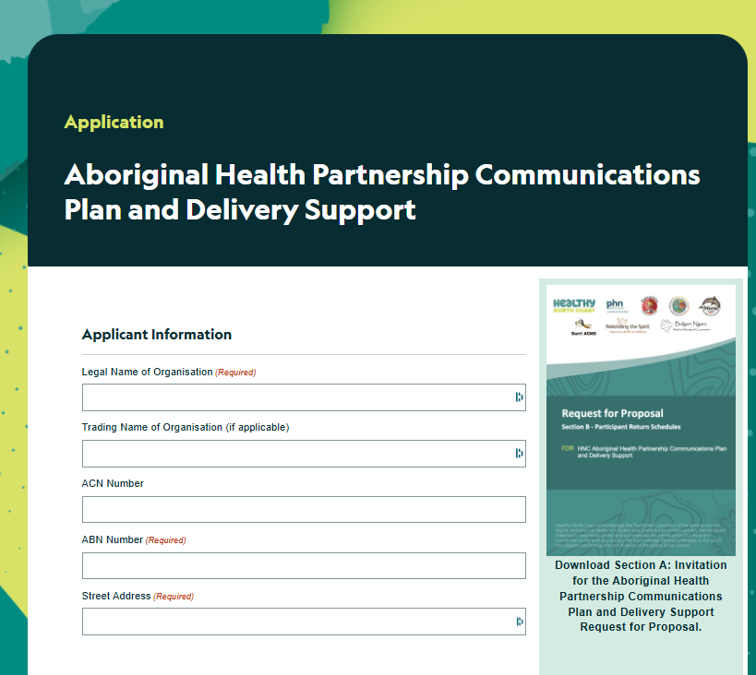

How to Apply
https://hnc.org.au/rfp-ahp-communcations-plan-and-delivery/

Slide 18
Application Requirements
Section b: participant return schedules
 | Information to be Submitted in application | Section B: Schedules
Request for Proposal | Applicant Details, Locations Applying for | Proposal Form
 | Demonstrated Experience | Schedule 1
 | Proposal | Schedule 2
 | Cultural Safety | Schedule 3
 | Organisational Capacity | Schedule 4
 | Value for Investment | Schedule 5
 | Referees | Schedule 6
 | Financial Capacity | Schedule 7
 | Insurance Details | Schedule 8
 | Conflict of Interest | Schedule 9
 | Acceptance and Declaration | Schedule 10

Slide 19
Insurance Requirements
HNC understands that applicants may not currently hold all the required insurances
Providers who do not currently meet one or more of the minimum insurance requirements are still encouraged to submit a response
HNC will work with the successful provider to meet the insurance requirements if they are not currently in place

Slide 20
Evaluation Criteria / Weighting
Criteria | Weighting
Demonstrated Experience | 20%
Proposal | 20%
Cultural Safety | 20%
Organisational Capacity | 20%
Value for Investment | 20%

Slide 21
Application process– estimated timeline
Milestone | Dates
RFP Closing | 19 May 2026, 5pm
Panel Evaluation – independent scoring | 20 May – 30 June 2026
Award Notification | From July 2026
Activity commencement | From July 2026

Slide 22
Conditions of Participation:
All enquiries in writing via HNC website
Enquiries must not be addressed directly to Staff or Board members of HNC
Maintain confidentiality
Review tender documents in full, and accept terms and conditions by signing the final declaration
For support and any other issues email commissioning@hnc.org.au

Slide 23
Questions?​
Any issues email commissioning@hnc.org.au​

