Slide 1
April Falls Month 2022
Better Balance for Fall Prevention

Slide 2
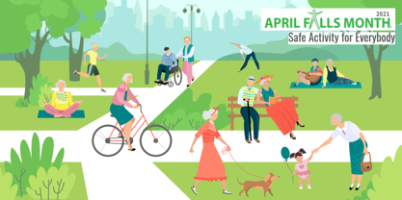
April Falls Month 2022
Theme: Better Balance for Fall Prevention
Easing of COVID-19 restrictions
An important time to encourage older people to:
Increase physical activity and embrace balance and strength exercises
Keep socially connected
Maintain a healthy diet
Overall aim to prevent falls in older people and promote healthy ageing

Slide 3
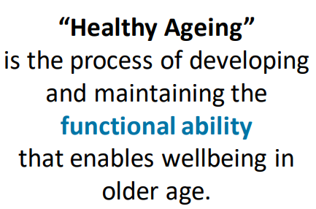
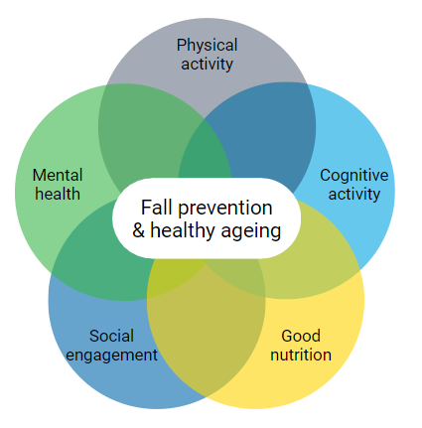
What is Healthy Ageing?
https://fallsnetwork.neura.edu.au/
the-network
https://www.who.int/ageing/decade-of-healthy-ageing

Slide 4
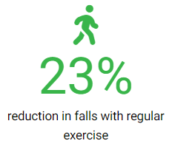
Healthy Ageing and Preventing Falls
April Falls Month 2022 aims to encourage older people to get physically and socially active in a safe environment.
Exercise of any type has been shown to reduce the risk of falling.
“…but slowly building up high-challenge balance exercises can increase the effects of exercise by up to 40 per cent”. – Professor Cathie Sherrington
Every move counts.
By safely achieving your goals you can move towards better health today

Slide 5
Healthy Ageing and Preventing falls
Balance & Functional Exercises
Resistance (strength) exercises
Tai Chi
Home based or group classes
Reduces the rate of falls and number of people who fall
May help prevent fall related fractures
Home based or group classes
Done in conjunction with balance training for best effects.
Benefits on fall rates when done alone are uncertain
Home based or group classes
Reduces the number of people who experience a fall and may reduce the rate at which people fall
Exercises that include balance and functional exercises and are undertaken for more than 3 hours per week are particularly effective.

Slide 6
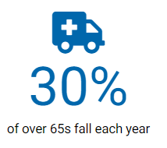
Falls Statistics
There is a large personal cost to falling
Leading cause of injury-related death in older adults (37%)
Leading cause of hospitalisation in older adults (41%)
30% suffer injuries requiring medical treatment
10-15% are serious injuries (e.g. fractures)
Hip fracture example:
50% discharged to nursing homes
25% never regain their pre-fracture mobility
25% die within 12 months
$3.9b
Estimated annual cost of falls nationally
AIHW 2019: Henley GE & Harrison JE. Trends in injury deaths, Australia, 1999–00 to 2016–17. Injury research and statistics series no. 127. Cat. no. INJCAT 207. Canberra: AIHW.
AIHW: Pointer SC 2019. Trends in hospitalised injury, Australia 2007–08 to 2016–17. Injury research and statistics series no. 124. Cat. no. INJCAT 204. Canberra: AIHW.

Slide 7
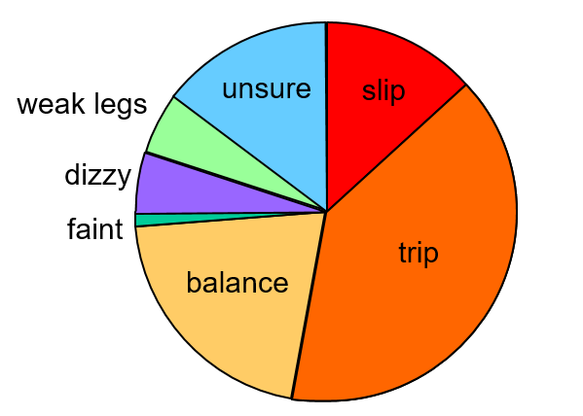
Fall Mechanisms
N=704 women aged 65-99 years
Randomly selected from the community
Slips, trips and balance problems account for almost ¾ of falls
Lord SR, Ward JA, Williams P, Anstey KJ. An epidemiological study of falls in older community-dwelling women: the Randwick falls and fractures study. Aust J Public Health. 1993 Sep;17(3):240-5

Slide 8
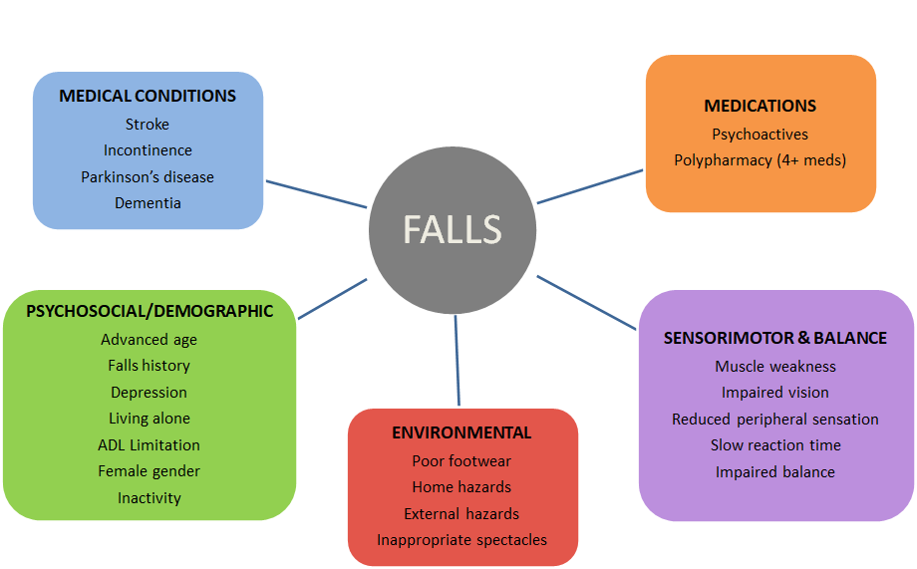
Risk Factors
Notes:
Risk factors can be screened and strategies can be put in place to mitigate risk. EG. Medications review or decluttering of home and living spaces
…but the gold standard for preventing falls is: Physical Activity

Slide 9
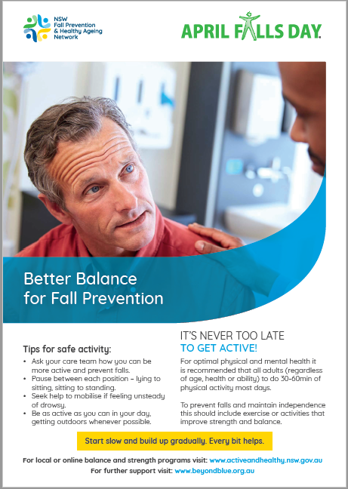
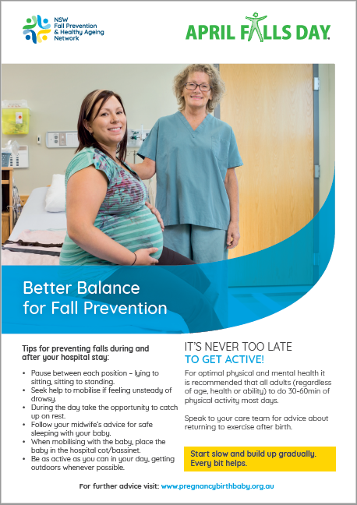
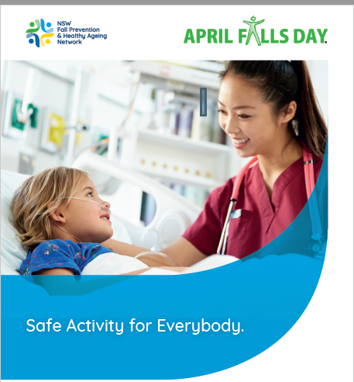
Falls don’t just only happen in older adults…

Slide 10
Physical Activity
Staying physically active is the single most important thing we can do to stay independent as we age
As people grow older, they lose muscle strength and balance – this can lead to a fall
To reduce the risk of injury from a fall it is important to improve balance and increase strength
High balance challenging exercises should be included in ALL exercise programs.
At least 30mins /day is recommended.
Initially make small changes, adding variety to maintain interest and gradually build up activities over time.
Share your health and fitness goals with your family, friends and work colleagues
Sherrington C, Fairhall NJ, Wallbank GK, Tiedemann A, Michaleff ZA, Howard K, Clemson L, Hopewell S, Lamb SE. Exercise for preventing falls in older people living in the community. Cochrane Database of Systematic Reviews 2019, Issue 1. Art. No.: CD012424.
WHO guidelines on physical activity and sedentary behaviour. Geneva: World Health Organization; 2020. Licence: CC BY-NC-SA 3.0 IGO

Slide 11
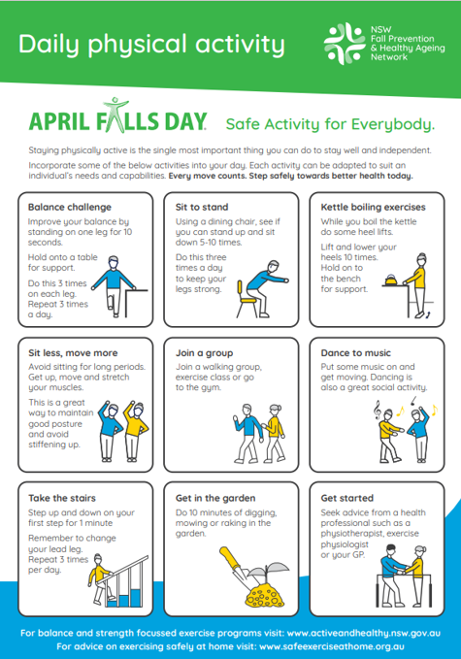
Daily Physical Activity: Campaign Flyer
Notes:
Tips on how to keep active

Slide 12
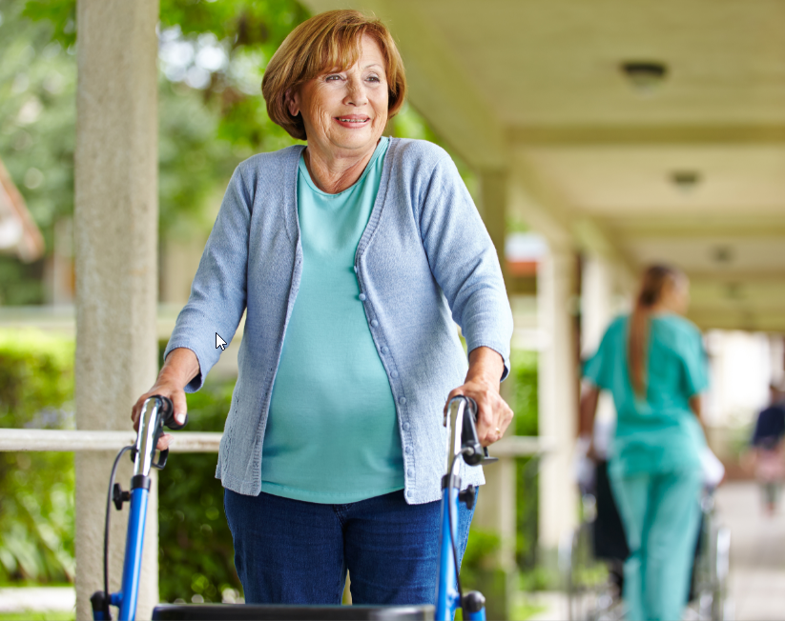
Benefits of Moving in Hospital
Prevent
effects of immobility (pressure injury)
functional decline
Maintain
independence with ADLs
balance and coordination
Improved
respiratory function
cardiopulmonary fitness
alertness and psychological well being
length of stay
appetite and sleep
Notes:
Slide from Moving right to stay upright CEC presentation

Slide 13
When Moving in Hospital
It’s important to engage with patients, family and carers re patients requirements when moving around the ward:
Do they need a walking aid?
Should they wait for staff to assist them to walk?
Do they have the right footwear and clothing?
Is the room free of clutter?
All staff have a role in safely mobilising patients

Slide 14
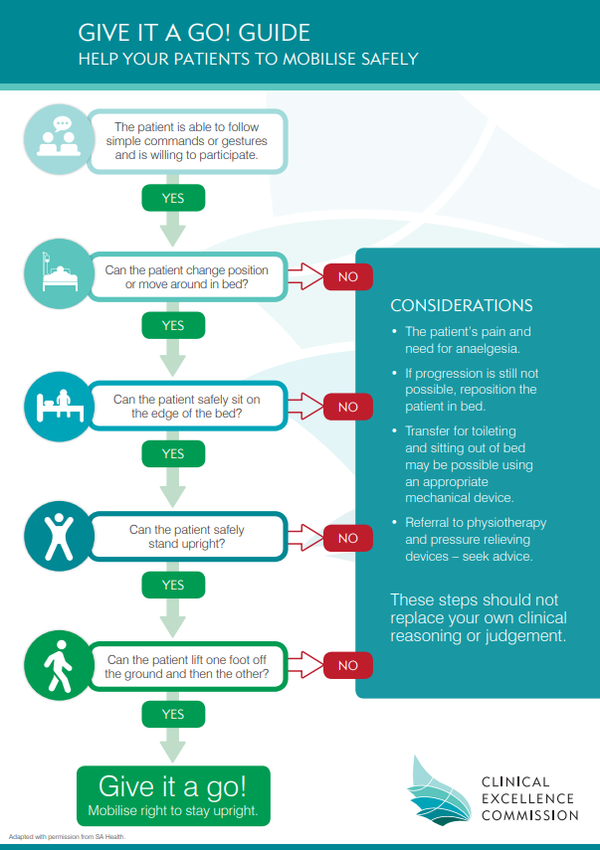
GIVE IT A GO! Guide
Helping staff to encourage safe mobilisation

Slide 15
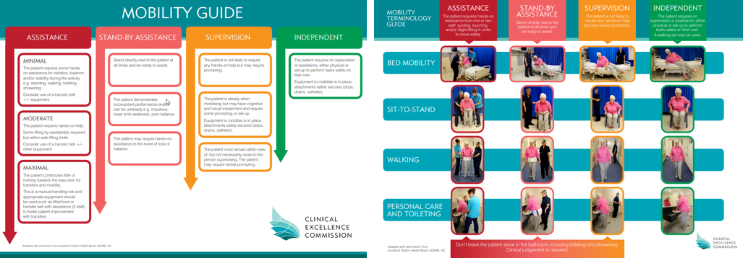
Safe Mobilisation
https://www.cec.health.nsw.gov.au/keep-patients-safe/falls-prevention/Leading-Better-Value-Care/safe-mobilisation

Slide 16
https://www.cec.health.nsw.gov.au/keep-patients-safe/falls-prevention/Leading-Better-Value-Care/safe-mobilisation

Slide 17
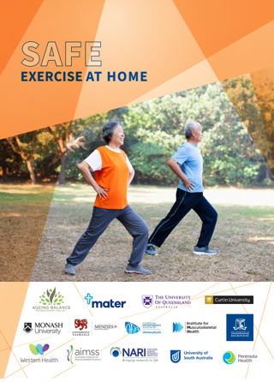
Safe Exercise Post Hospital Stay
Discharge Planning
Communicate falls risk status and care plan:
Patient, carers, families
GPs
Residential Aged Care facilities
Community Health Services: nursing, allied health
Other health providers
Community Service Providers
Safe exercise at home - a great resource for post hospital stay
https://www.safeexerciseathome.org.au

Slide 18
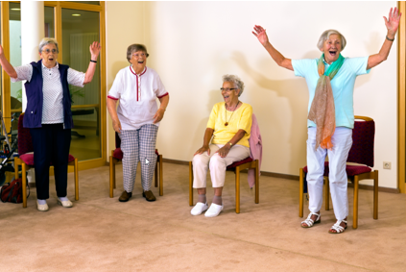
Social Engagement
Feeling socially connected can:
Improve your quality of life
Boost your mental health
Increase levels of happiness
Increase feelings of belonging
Result in fewer health problems
Help you live longer

Slide 19
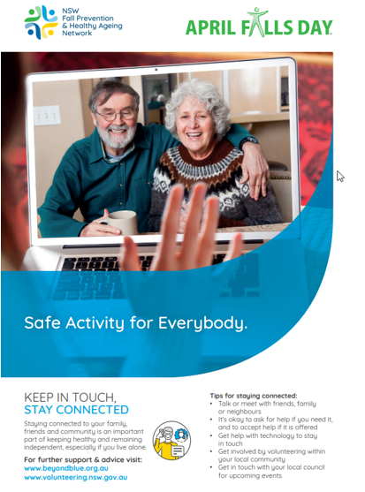
Social Engagement: Campaign flyer
Notes:
Flyer provides tips for staying connected.

Slide 20
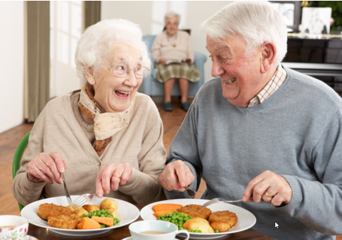
Healthy Eating
Eating well to prevent falls
Eating healthy food with adequate energy and protein is important to maintain:
muscle mass
muscle strength
To reduce the risk of:
sarcopaenia (muscle wasting)
frailty and
fall-related injury
Notes:
From nutrition and hydration – eating well to prevent falls CEC april falls preso

Slide 21
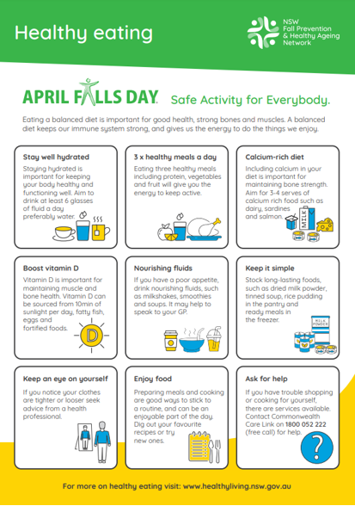
Healthy Eating: Campaign Flyer

Slide 22
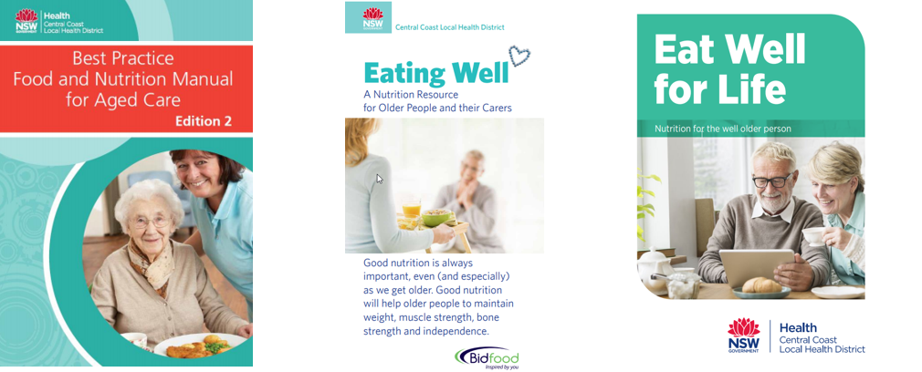
Healthy Eating
https://www.cclhd.health.nsw.gov.au/services/nutrition/nutrition-resources
CC LHD Public Health Nutrition resources for use Australia wide. The aim is to maintain or improve the nutritional health of older people.

Slide 23
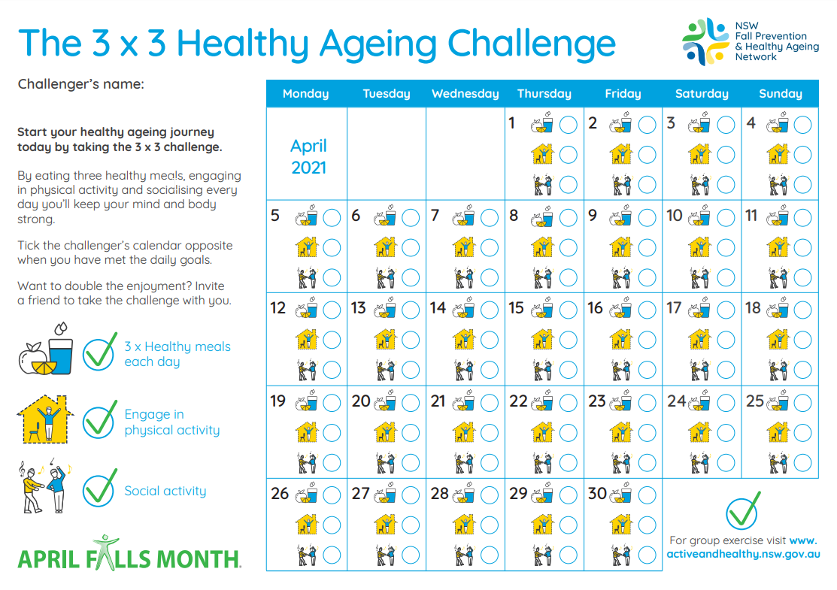
3x3 Healthy Ageing Challenge
For staff, patients and care-givers:
Share your health and fitness goals with your family, friends and work colleagues!

Slide 24
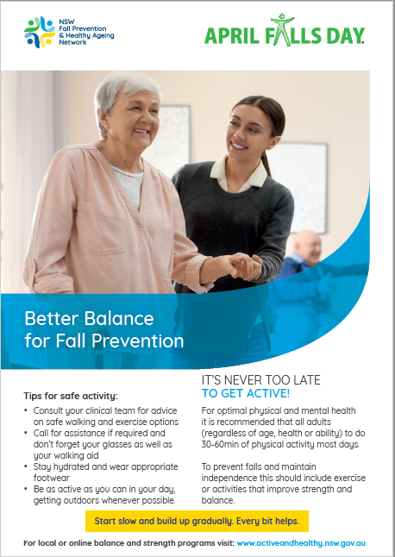
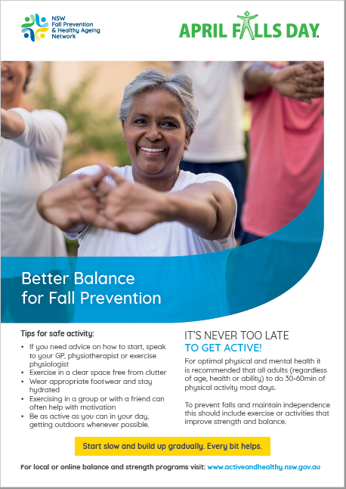
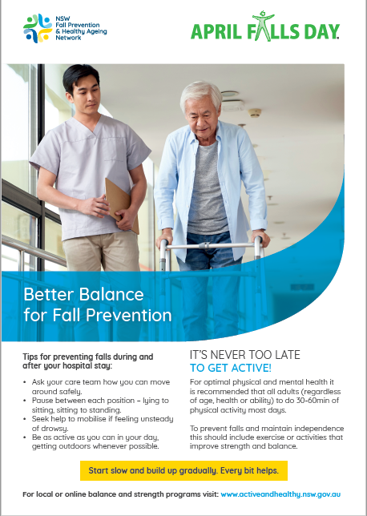
Campaign Materials – Care Settings

Slide 26
Acknowledgements
The April Falls Working Group
Natassia Smith
Cameron Hicks
Kamilla Haufort
Margaret Armstrong
Allison Wallis
Sharon Butler
Ingrid Hutchinson
Rik Dawson
Bron McCrae
Maryann Anderson
Prof Cathie Sherrington
Resources for Slides
Eating well to prevent falls slide. Information from the CEC Nutrition and Hydration –presentation (https://www.cec.health.nsw.gov.au/__data/assets/pdf_file/0004/586192/Nutrition-and-Hydration-Eating-Well-to-Prevent-Falls.pdf)
Moving right to stay upright presentation – (https://www.cec.health.nsw.gov.au/__data/assets/pdf_file/0008/399689/Moving-Right-to-Stay-Upright-Presentation.pdf)
Clinical Excellence Commission https://www.cec.health.nsw.gov.au/keep-patients-safe/falls-prevention/Leading-Better-Value-Care

