Slide 1

Produced by Be Someone For Someone Research Advisory Committee
Prof Susan Nancarrow
Dr James Cowley
David Donnelly
Jo Winwood
REDUCING
LONELINESS
PROPOSED FRAMEWORK

Slide 2
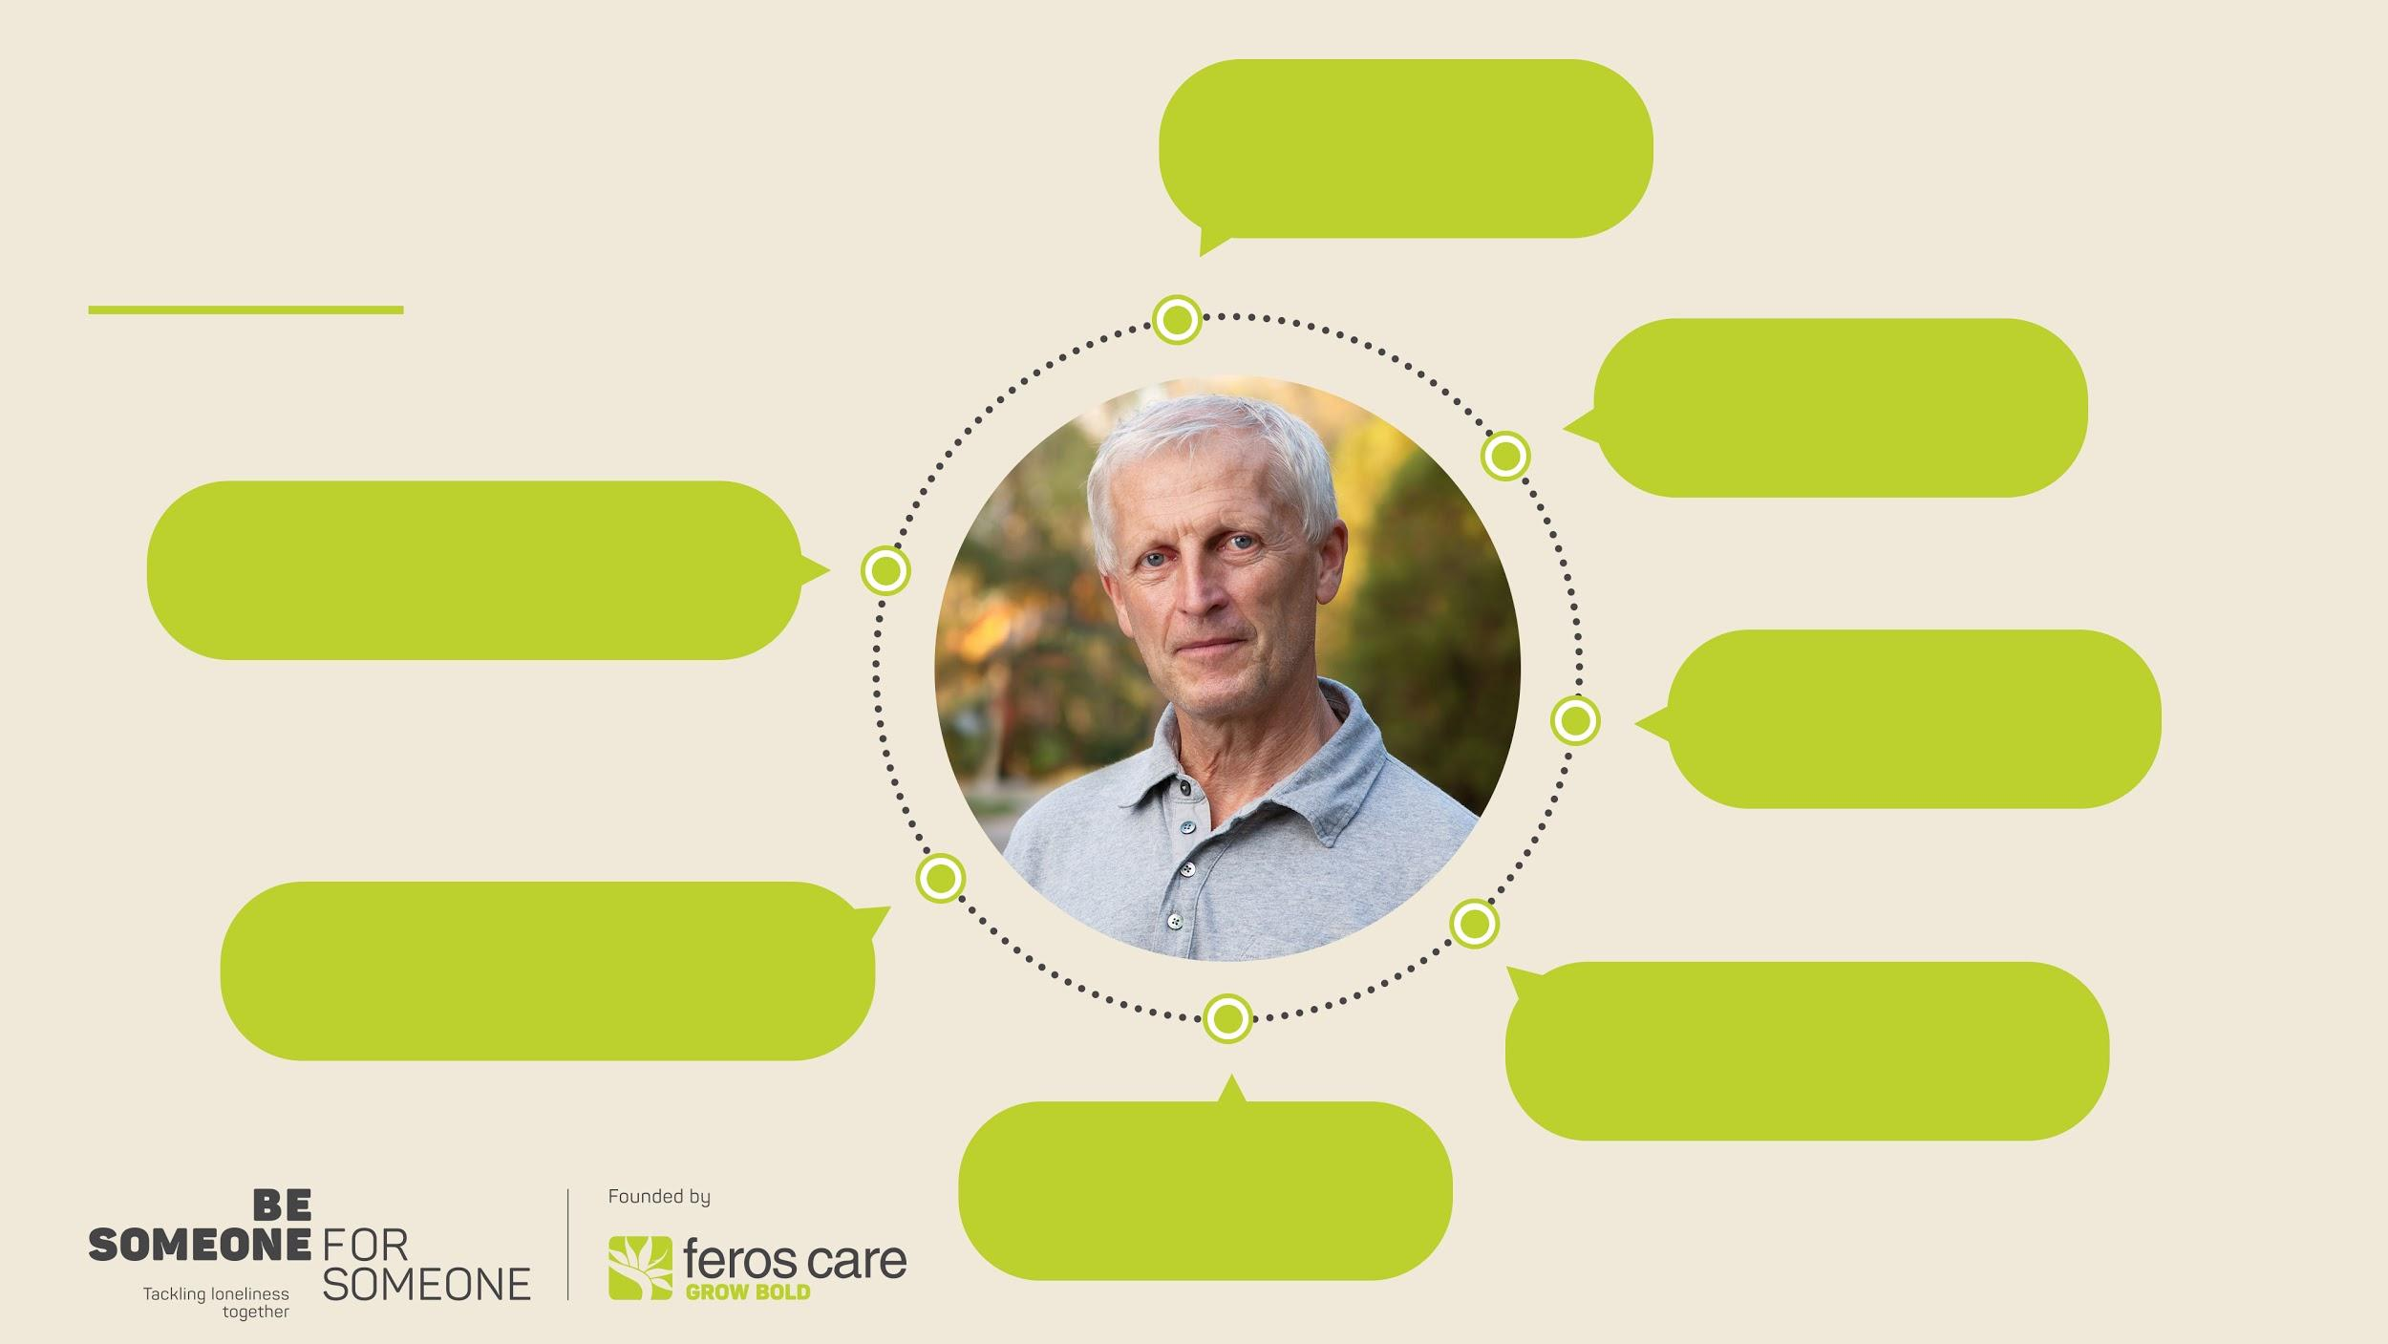
UNDERSTANDING
LONELINESS
Loneliness and isolation can be linked, but are not the same
Loneliness -the feeling of not having the social connections we need
It could be about handling the
lonely feeling and
emerging from it (transient)
Loneliness has a purpose – to drive us to create vital social connections
It’s not just about creating lots of
connections for people. It's about
the depth of the relationships
One can feel socially isolated
and not identify close friends
yet not be lonely
One can be socially
very connected and yet
be lonely

Slide 3
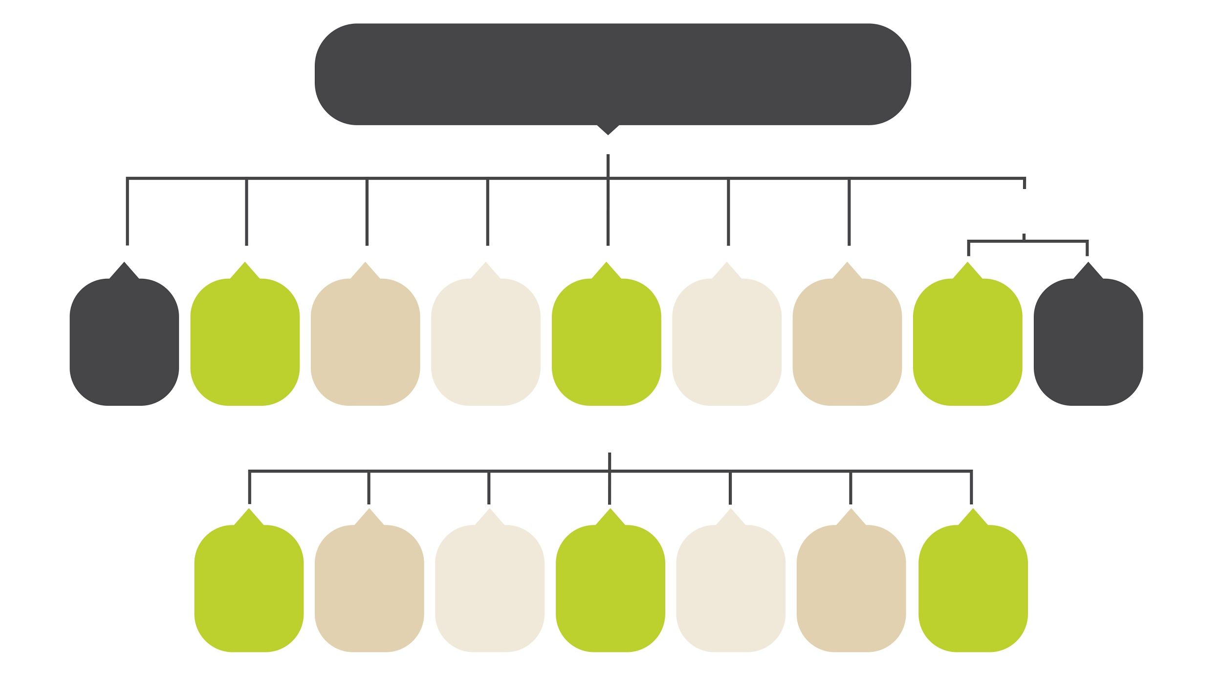
HEALTH AND SOCIAL
IMPACT OF LONELINESS
POOR MENTAL HEALTH
Premature mortality (ARN02)
Chronic disease /physical lealth decline
Young people - Sucide
Low levels of
self worth
Reduced
life satisfaction
Lack of drive
Older people -premature death
Generalized anxiety and depression
Suicidal ideas
SUBJECTIVE
Not fitting in
Perception
of danger in neighbourhood
Poor economic
outcomes
Lack of confidence and self esteem
Stigma of being lonely
Ageism
Lack of opportunity
Notes:
V

Slide 4

COST OF
LONELINESS
UK prediction of the health impact per year is
£2.5 Billion; £6000 sterling for a decade of an older
adults life (ARN59). Potential Australian parallel $1.5b
Research suggests depression is the biggest disability globally and that loneliness is the biggest contributor to depression. The reverse is also true- social connections are seen as the single most protector against depression regardless of its cause (clinical, trauma etc0

Slide 5

INDIVIDUAL
CONCEPTUAL FRAMEWORK FOR LONELINESS
KEN WILBER’S iNTEGRAL MODEL (AQAL MODEL – 1996)
INDIVIDUAL AGENCY
Values, beliefs, ethics
Physical and emotional health
Self awareness
Self confidence
Emotional intelligence
Personality preferences
Worldview
LEARNED BEHAVIOURS AND SKILLS
Behaviours
Actions
Skills
Competencies
Performance
INTERNAL
EXTERNAL
CULTURE AND BELONGING
Family and relationships
Collective values
Collective paradigms
Collective worldviews
Relationships
Organisational Culture
Stories
SOCIAL SYSTEMS
Policies
Processes
Systems
Laws
Infrastructure
COLLECTIVE

Slide 6
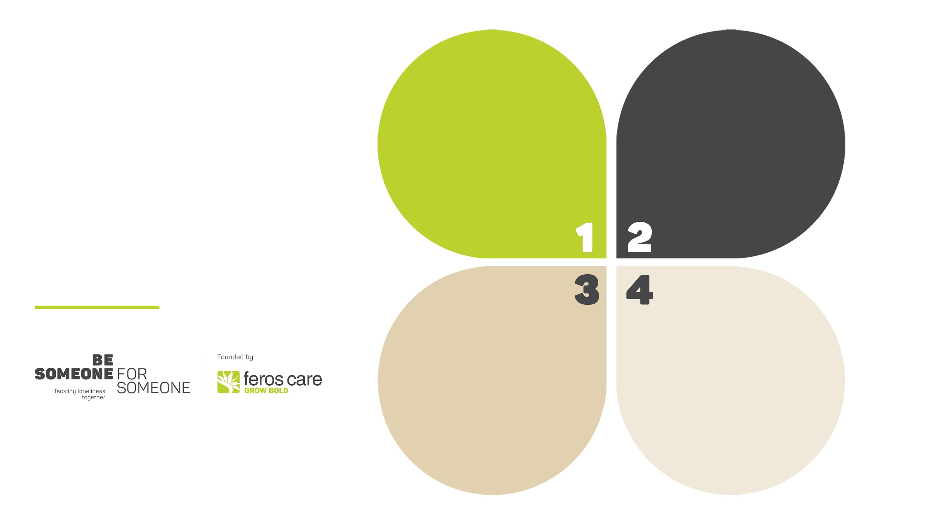
TYPE 1
MENTAL OR NEUROLOGICAL DISABILITY
TYPE 2:
THAT’S LIFE
Caused by ongoing circumstances . Generally common to groups in the same situation. Eg
unsociable employment, cultural dislocation, single parenthood
Rresulting from certain illnesses
Biological / biopsychosocial complications/ mental health, physical or psychological disability
FOUR
TYPES OF LONELINESS
TYPE 3:
LIFE’S TRANSITIONS
TYPE 4:
STRUCTURAL
LONELINESS:
Caused by infrastructure and environment
influencing the way we connect and engage.
Eg COVID19 and social
isolation, town planning, socialmedia
Caused by a change in
circumstances, such as a specific event or change in life.
Eg divorce, bereavement, becoming a single parent, recent unemployment

Slide 7

RISK FACTORS
FOR TYPE 1
DIAGNOSIS IMPLIES A SPECIALISED TREATMENT IS REQUIRED
For example
Mental disability
Depression
Anxiety disorders
Intellectual disability
PTSD
Notes:
People in this group are experiencing loneliness as part of or wholly as a result a broader mental or neuroligical disability which is preventing them form enjoying meaningful social connections.
It is most likely that people in this group will need specialist mental health treatment as part of the solution to their loneliness.

Slide 8
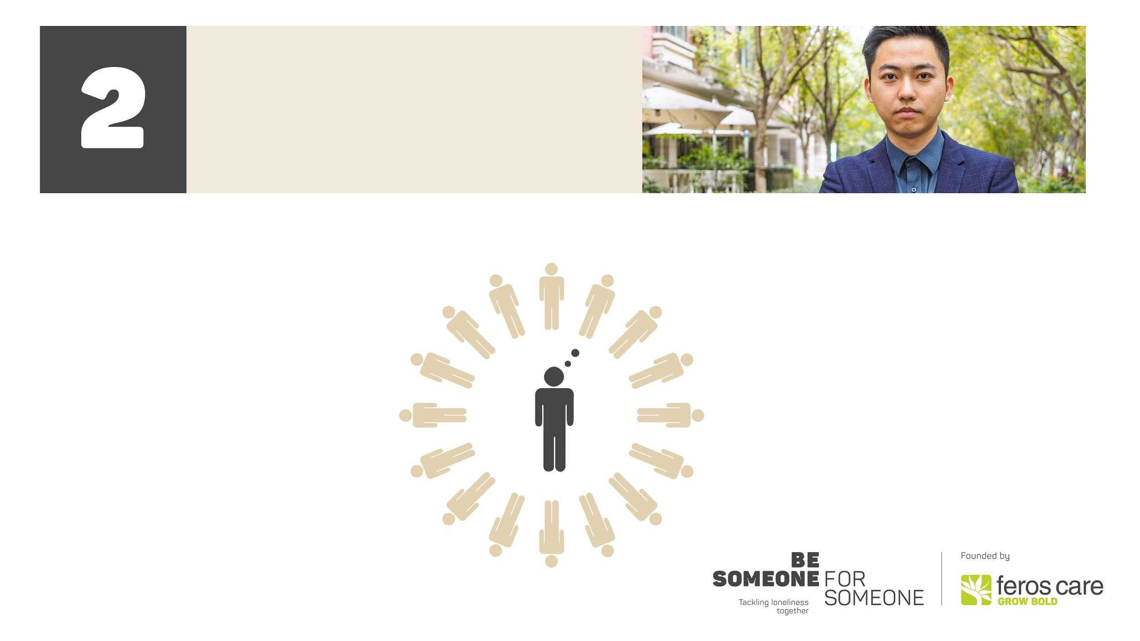
RISK FACTORS
FOR LONELINESS TYPE 2
(SITUATIONAL ATTRIBUTES)
Living alone
Social media reliance
Victim of abuse
Geographically distant from friends and family
Lack of social skills
Lack of mobility
Unsocial ongoing employment eg FIFO, shiftwork
Ex Servicemen and women
Living remotely
Caring for others
Over employment
Cultural dislocation (migrants/refugees)
Marginlalised groups
Long term /permanent unemployment
Demographic risk factors
  - Single men, living alone 35-44,
              - Single parents with children younger than 15
                -Women 35-54
              -Men over 75

Slide 9

RISK FACTORS
FOR TYPE 3
(CIRCUMSTANTIAL) LONELINESS
Recent separation or divorce
Becoming a single parent
No longer being in a workplace
Over employment
Change in social circle
Leaving care
Leaving an institution e.g. education or defence
Inability to access social activities
Social changes due to relocation
Becoming
a carer
Onset of physical impairment
Period of poor health
Moving out of independent living
Children leaving home
Retirement
Becoming homeless
Becoming a parent
Bereavement

Slide 10

RISK FACTORS
FOR TYPE 4
(STRUCTURAL) LONELINESS
Town planning
Reliance on technology as a communication tool
Cultural norms around connecting with others
Physical and mental safety
Changes to the way a culture socializes
Housing infrastructure, cost, layout, facilities
Housing design
Limited public transport
Poor Digital services (eg connectivity)
Neighbourhood infrastructure
Community facilities
Stigma around loneliness
Loss of social capital and belonging (clubs/church etc)
Current culture of self over community
Discrimination
Social media growth
Pandemic – enforced isolation

Slide 11

TYPE 1
TYPE 3
Interventions focus on treating the underlying medical / organic causes of loneliness
Medical management of mental health conditions
Medical and psychological support for psychological disability
Services to support physical disability
Access to a safe and supportive environment
Many of these are transient / temporary and triggered by chnage. To prevent resulting chronic loneliness interventions should be targeted to groups in need such as
Bereavement support
Parenting support groups
Retirement transition support
INTERVENTIONS
TO REDUCE
LONELINESS
TYPE 4
Interventions focus on societal / structural responses to reducing loneliness and social isolation
Changes to the way a culture socializes
A culture where you can talk to strangers
Town Plannig
Community and nieighbourhood engagement
Housing infrastructure, cost, layout, facilities
Neighbourhood infrastructure eg Walk and talk areas and shared facilities
Community perception of loneliness
Cultural inclusion and inntegration
Support communities at grass roots level
TYPE 2
Interventions focus on skills to respond to circumstantial loneliness and create structures to reduce loneliness
Skills to build resilience
Opportunities to socialise
Skills to support socialisation
Social engagement through employment
Change of employment structure

Slide 12

AT A NATIONAL OR GOVERNMENT LEVEL
Create a peak body of those in the field and government to create strategy, priorities and funding
Create a research of academic and commercial researchers to support the above
BE SOMEONE FOR SOMEONE
General
  Collaborate with others
  Where something is working share it far and wide
Conduct further Economic Research to estimate the cost of the four types of loneliness
Approach designing individual programs as follows:
Select priority areas in each of the four types of loneliness
Set up programs in relevant collaborations based on areas of expertise or reach
Ensure understanding of issue and avoid duplication with focused literature review
Qualitative research of small group to understand better the attitudes, perceptions and behaviours of the target groups
Design and test the concept with small group of sufferers from specific target group and any other stakeholders
Run pilot programmes with action research / qualitative research / program refinement research i.e. broad evaluation as well as results
Maximise the outcomes where successful, move to a fast scaling up of programs. Where not successful, diagnose where the blocking points were and whether a program could be redesigned to be more successful
RECOMMENDATIONS

